Slide 1
presentation about an experiment with salt
Science Olympics

Slide 2
How to make salt crystals ?

Slide 3
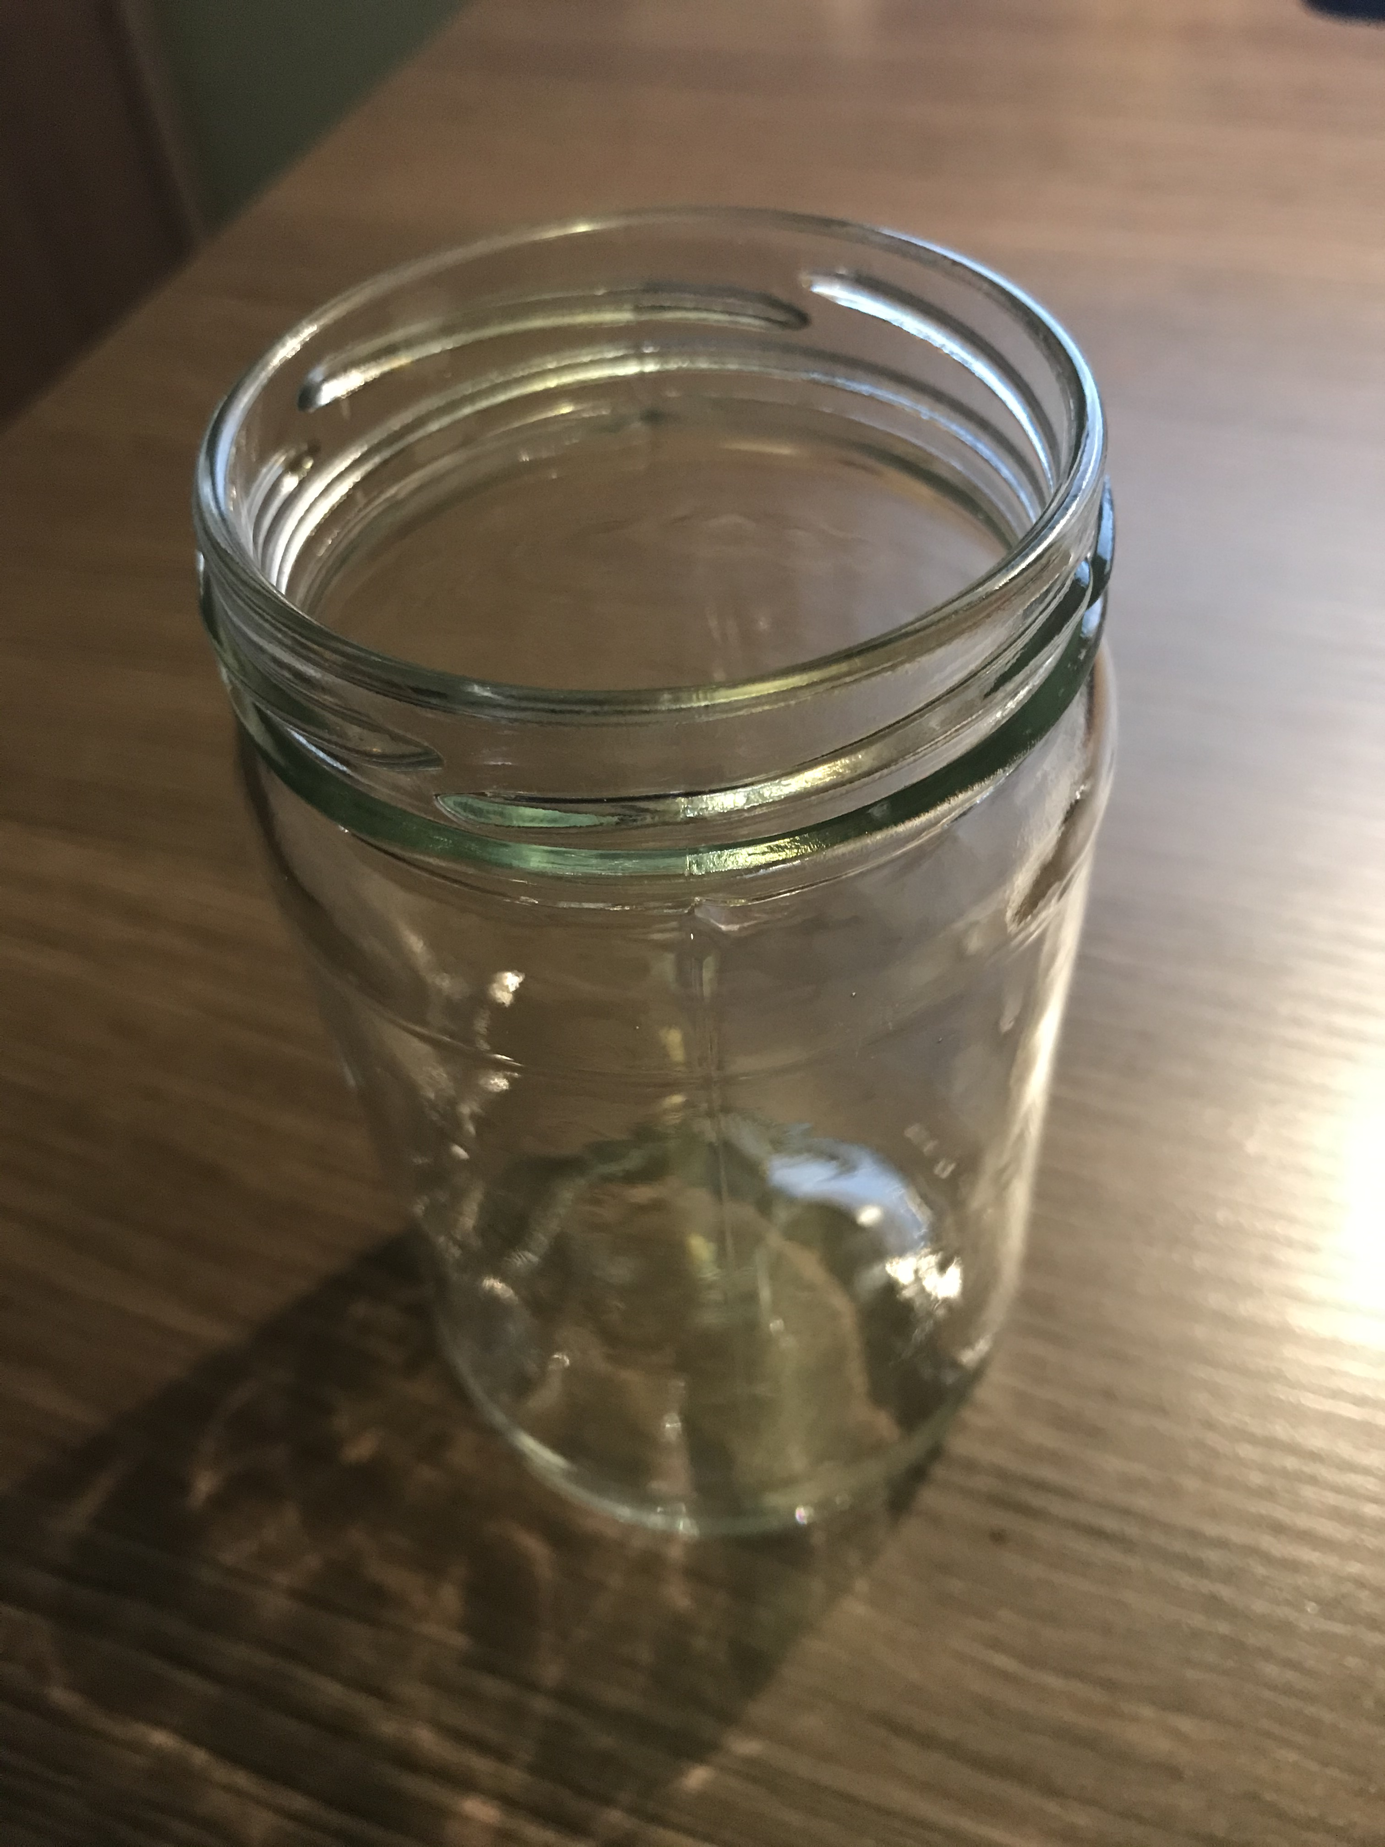
Materials:
CLEAR GLASS JAR

Slide 4
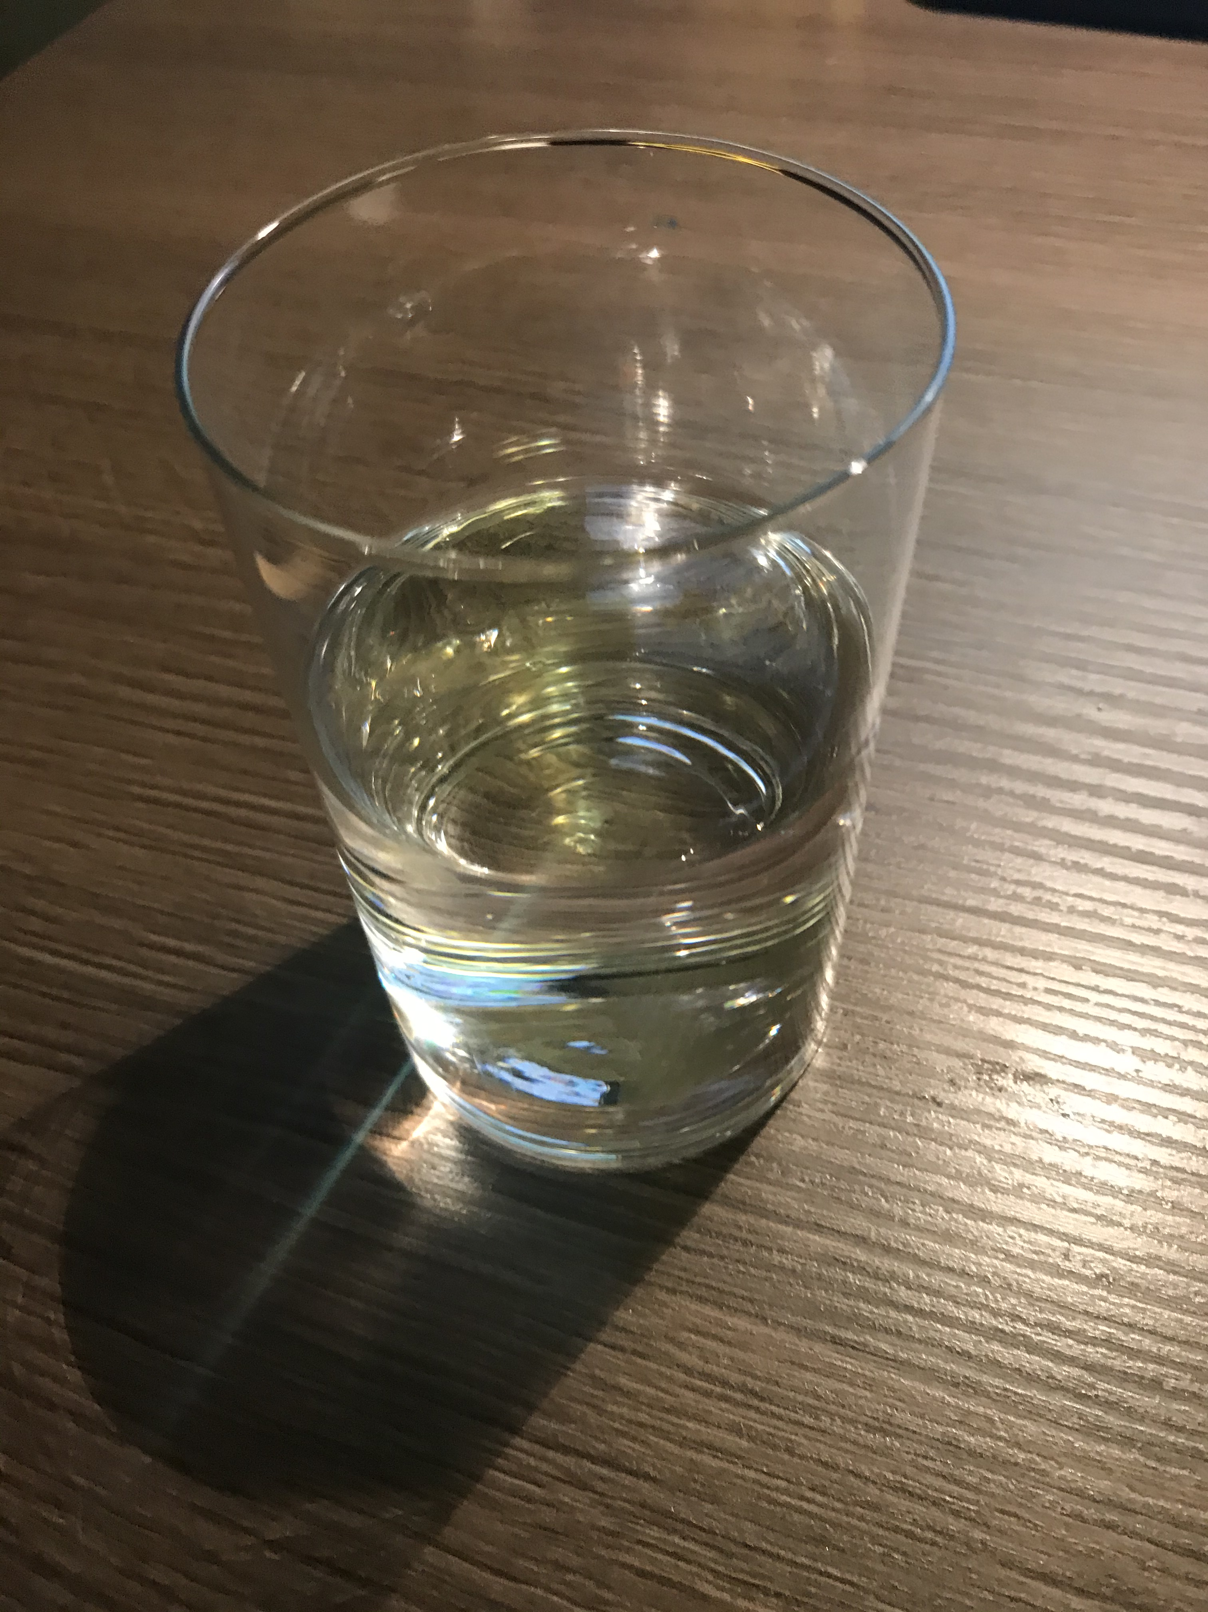
Materials:
HOT WATER

Slide 5
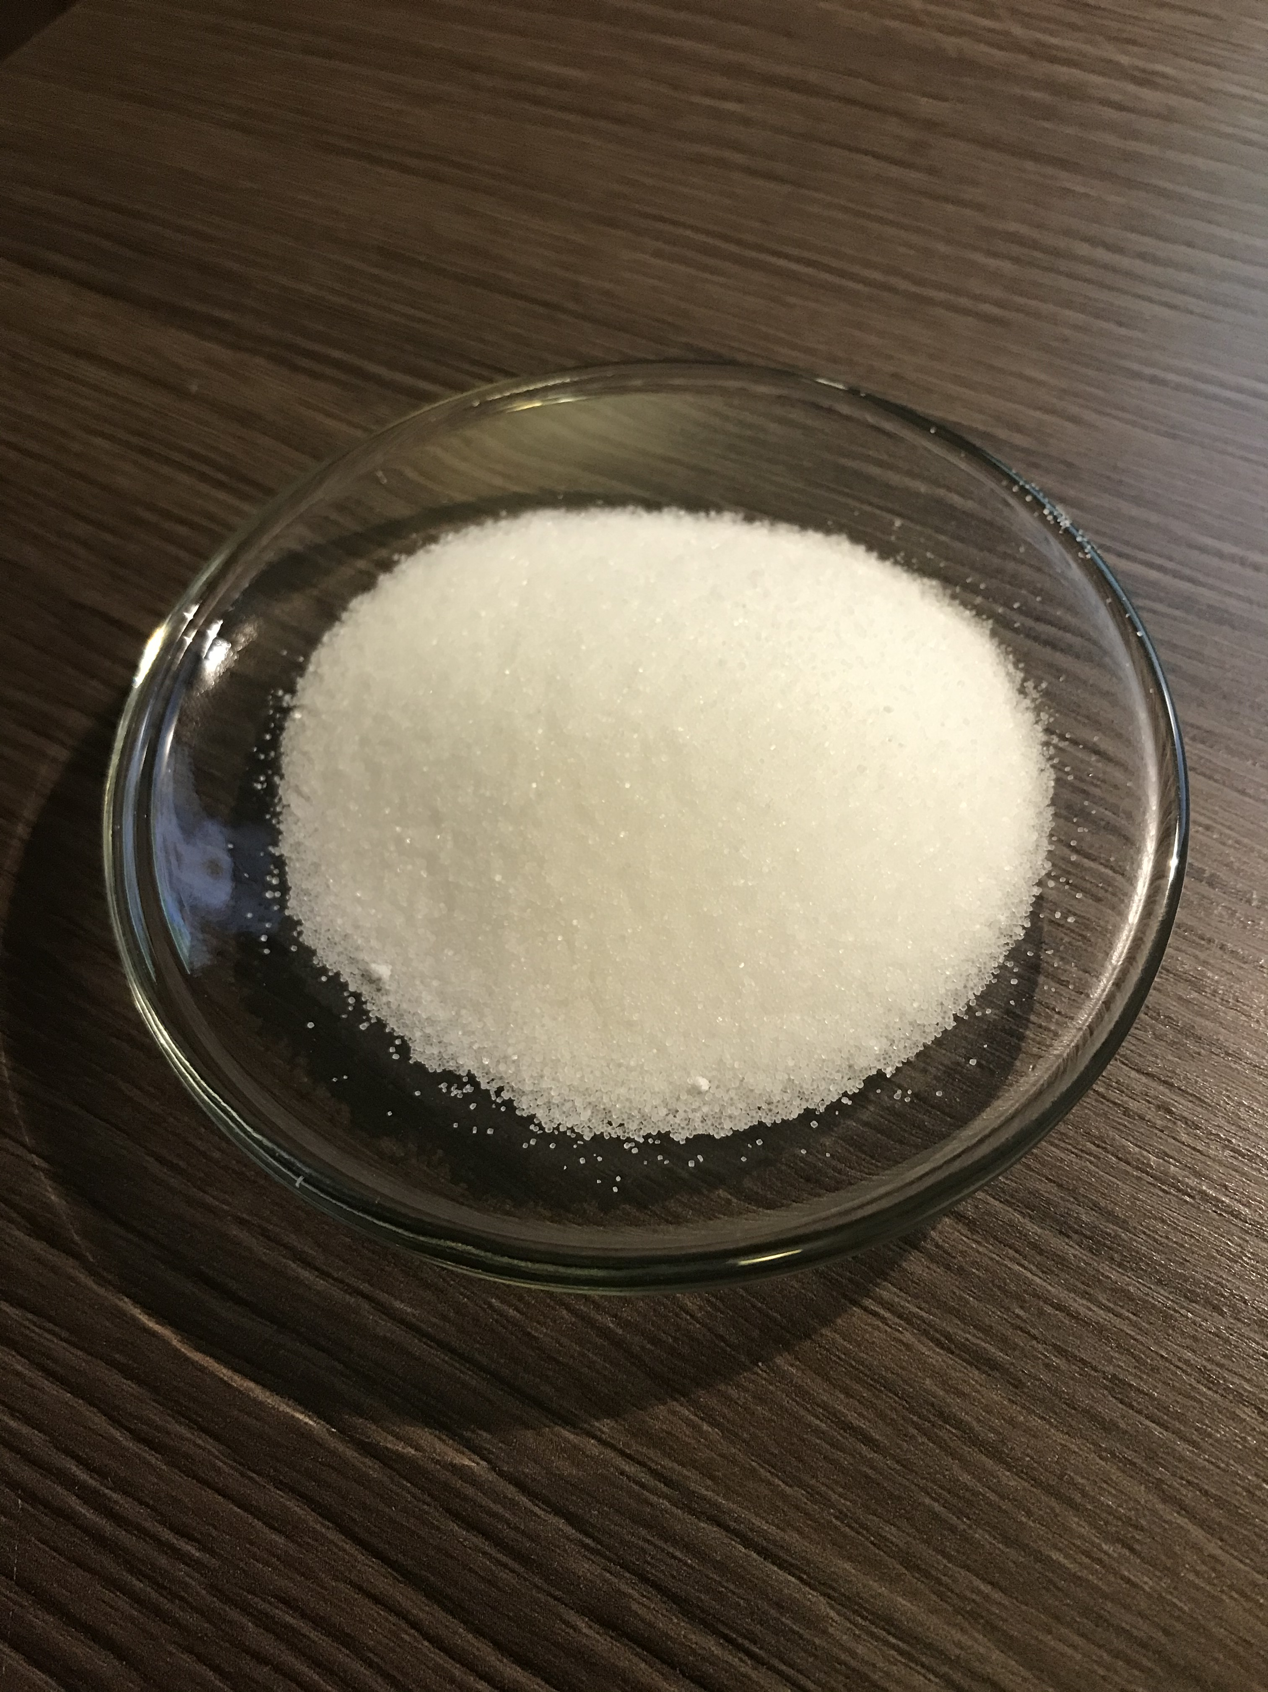
Materials:
SALT

Slide 6
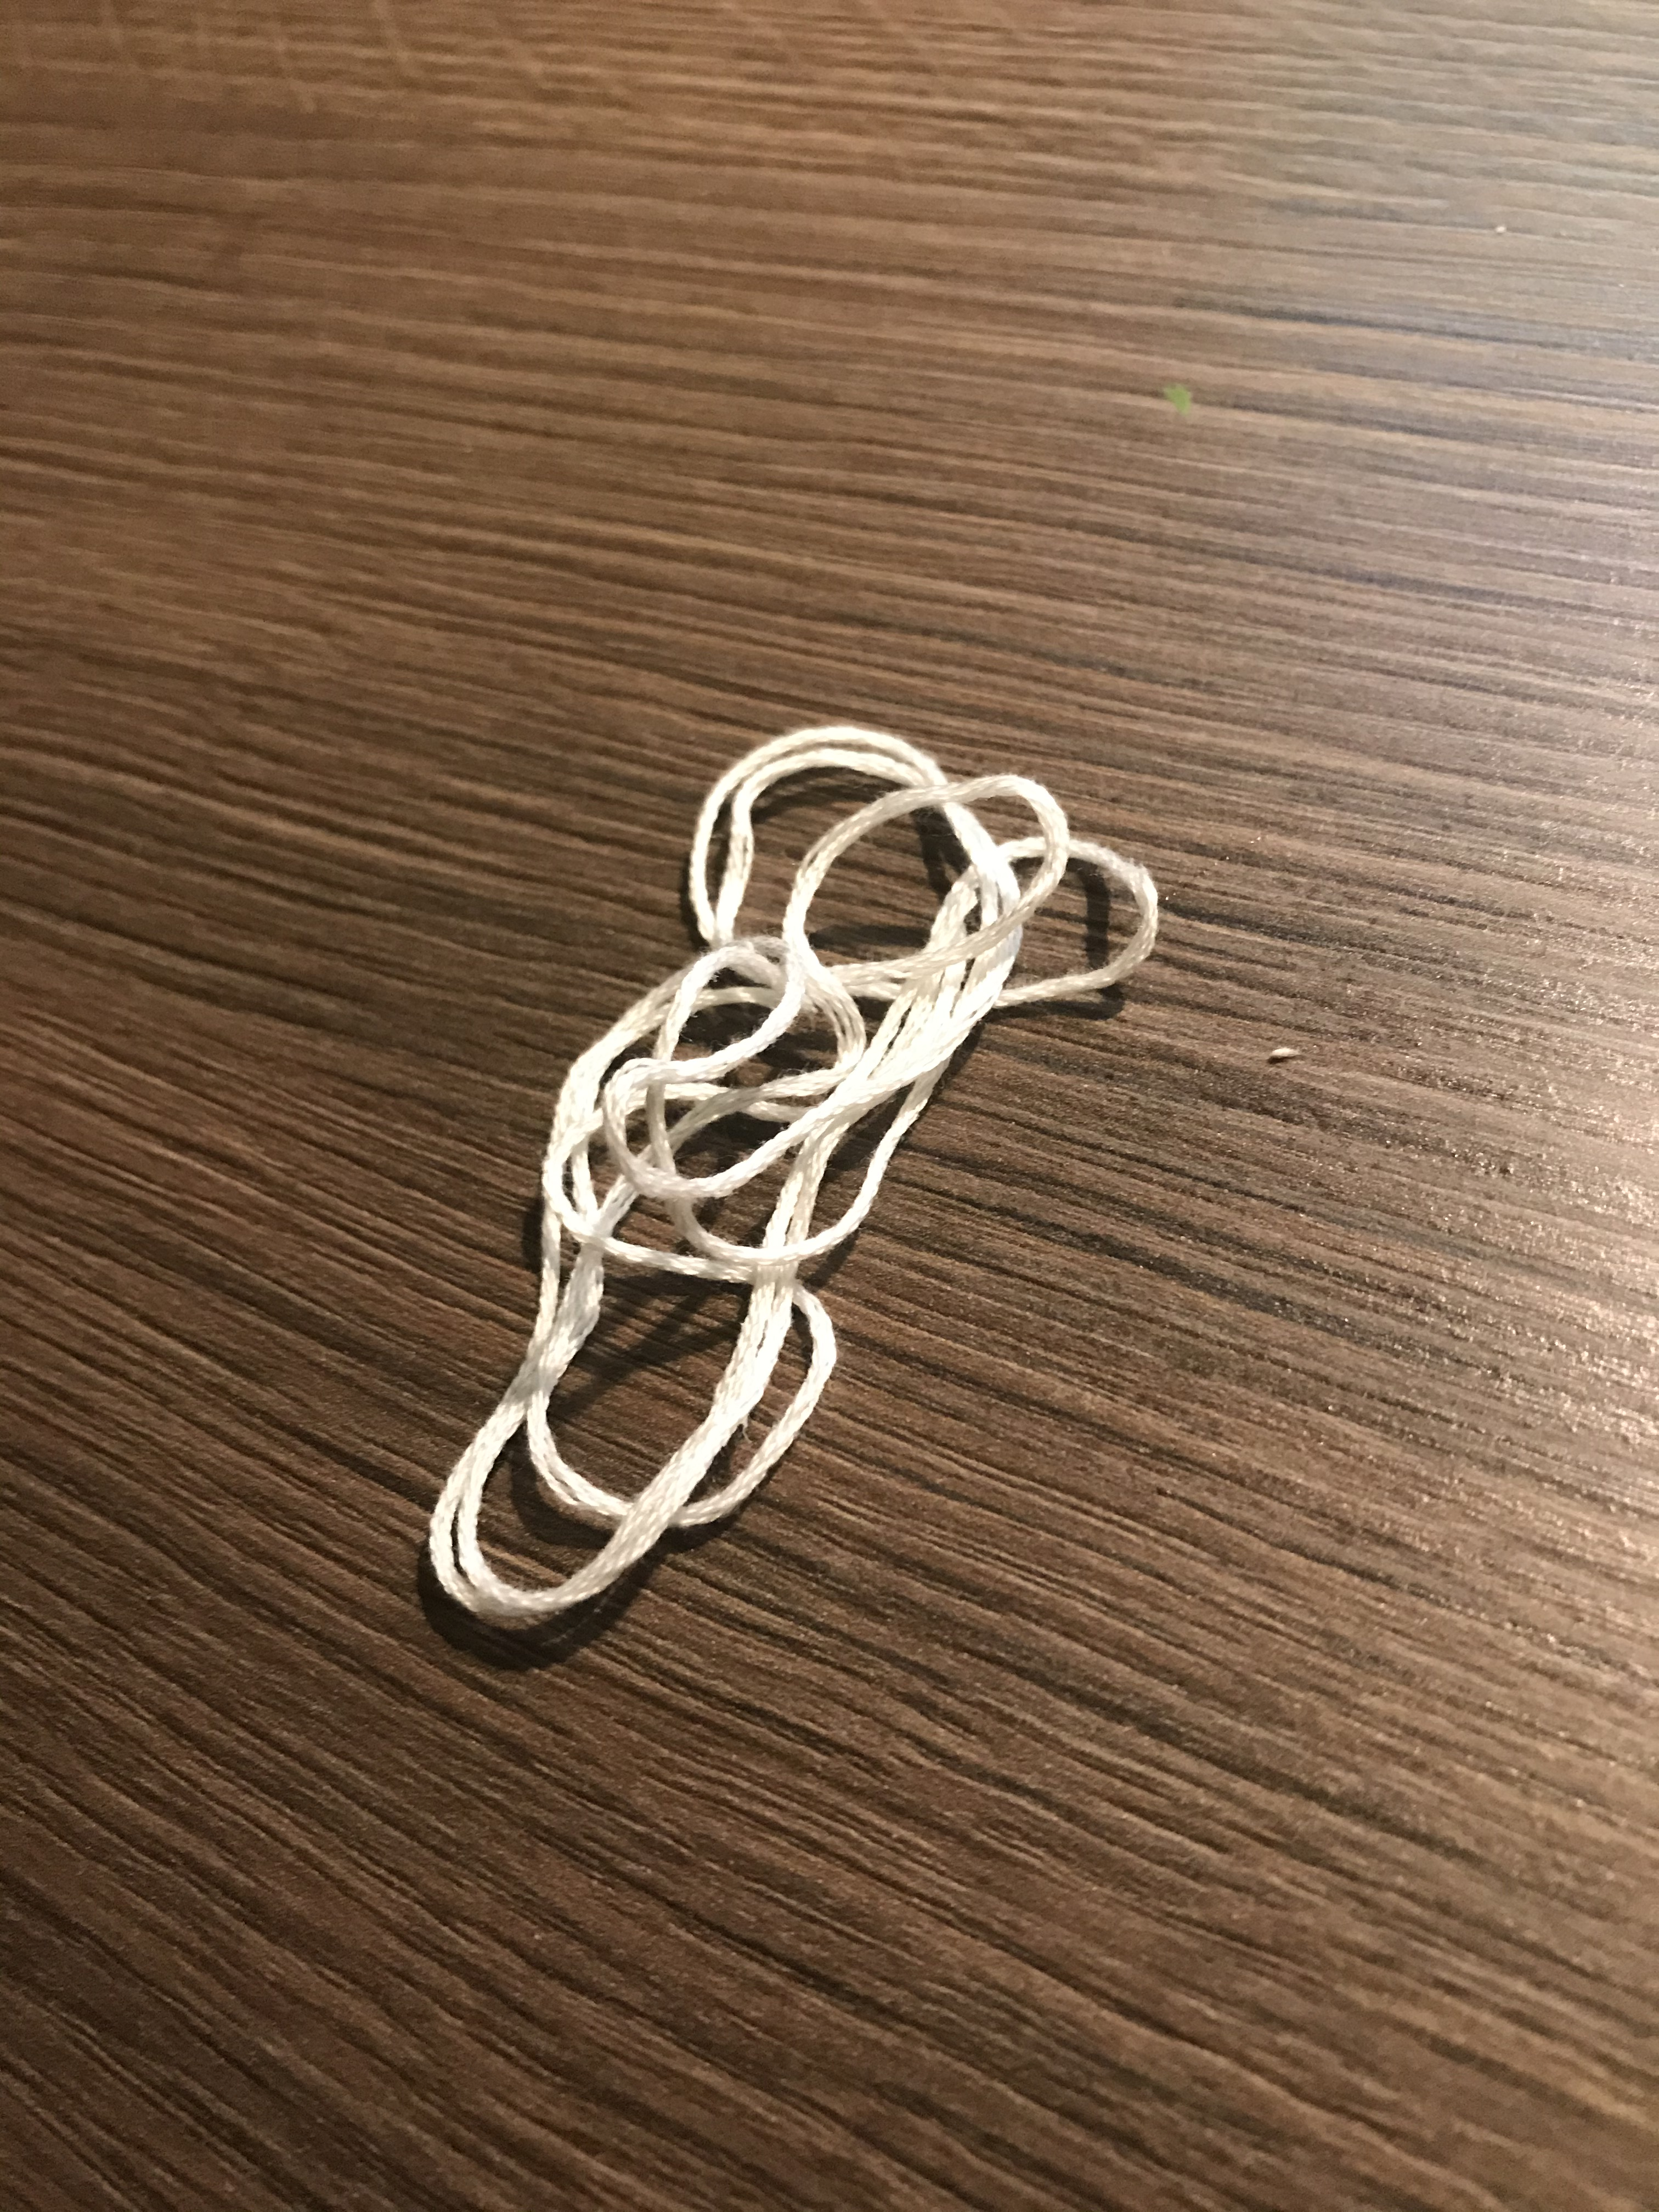
Materials:
COTTON STRING

Slide 7
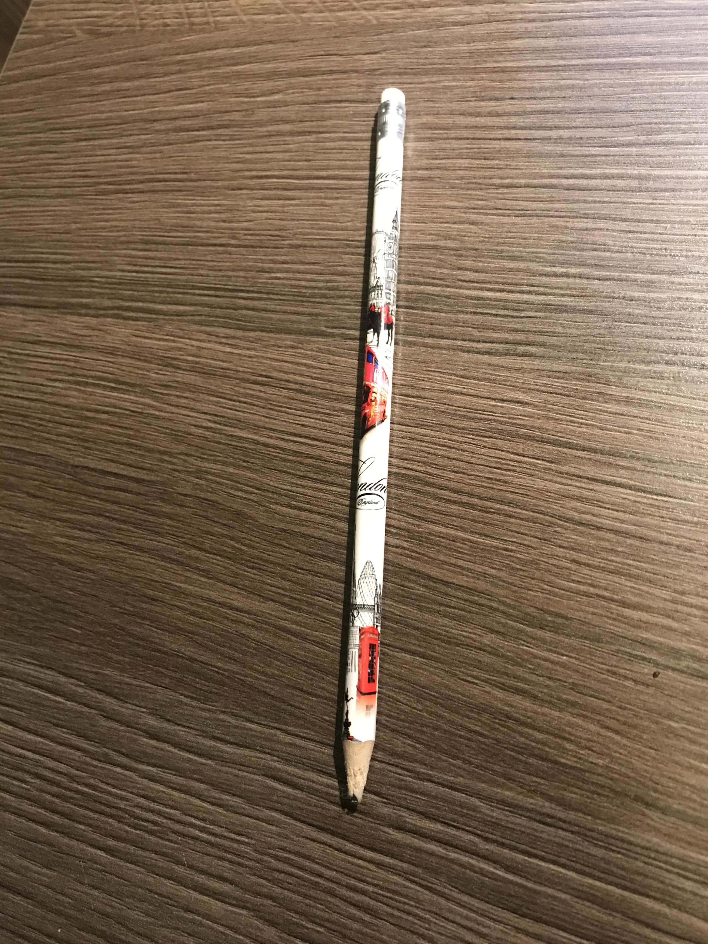
Materials:
A PENCIL OR A STICK

Slide 8
STEPS:
Add salt to hot water in a glass jar.
Stir well until all salt is dissolved.
Tie one end of the string to the middle of your pencil.
Place the end of the string into the solution and lay the pencil across the opening of the jar.
Wait few days.

Slide 9
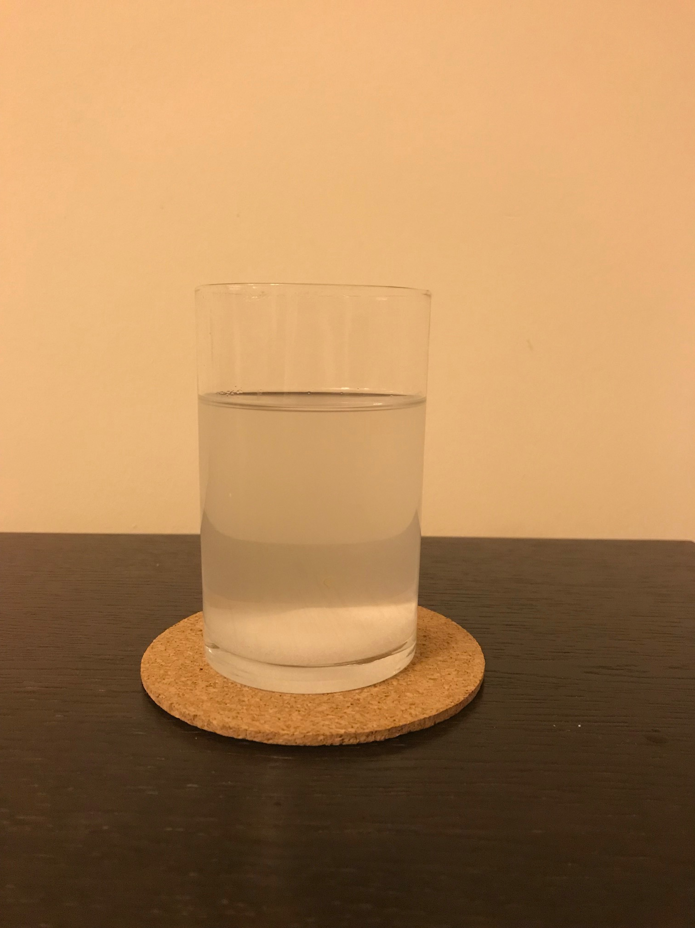
DAY 0

Slide 10
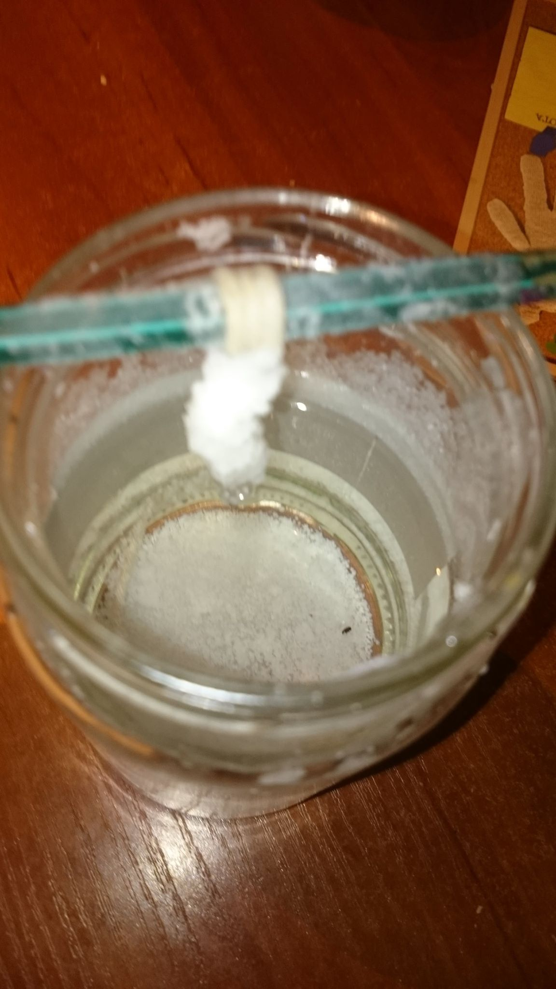
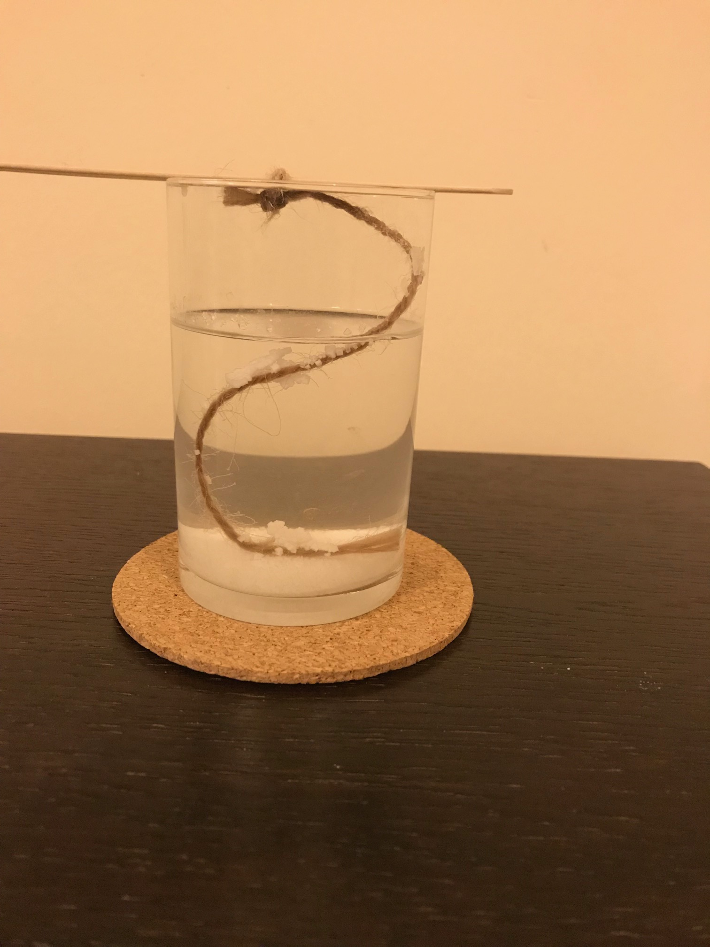
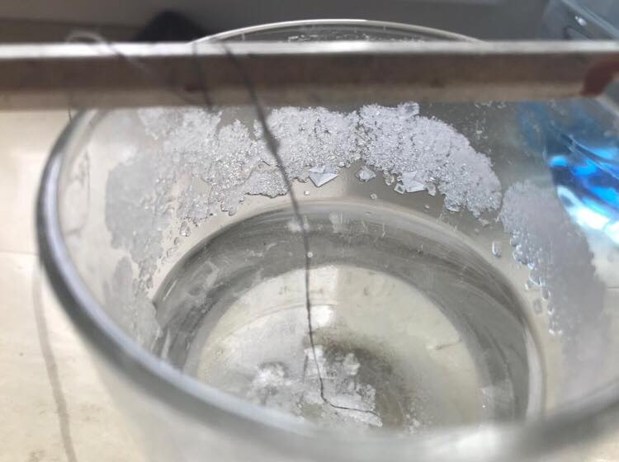
DAY 1

Slide 11
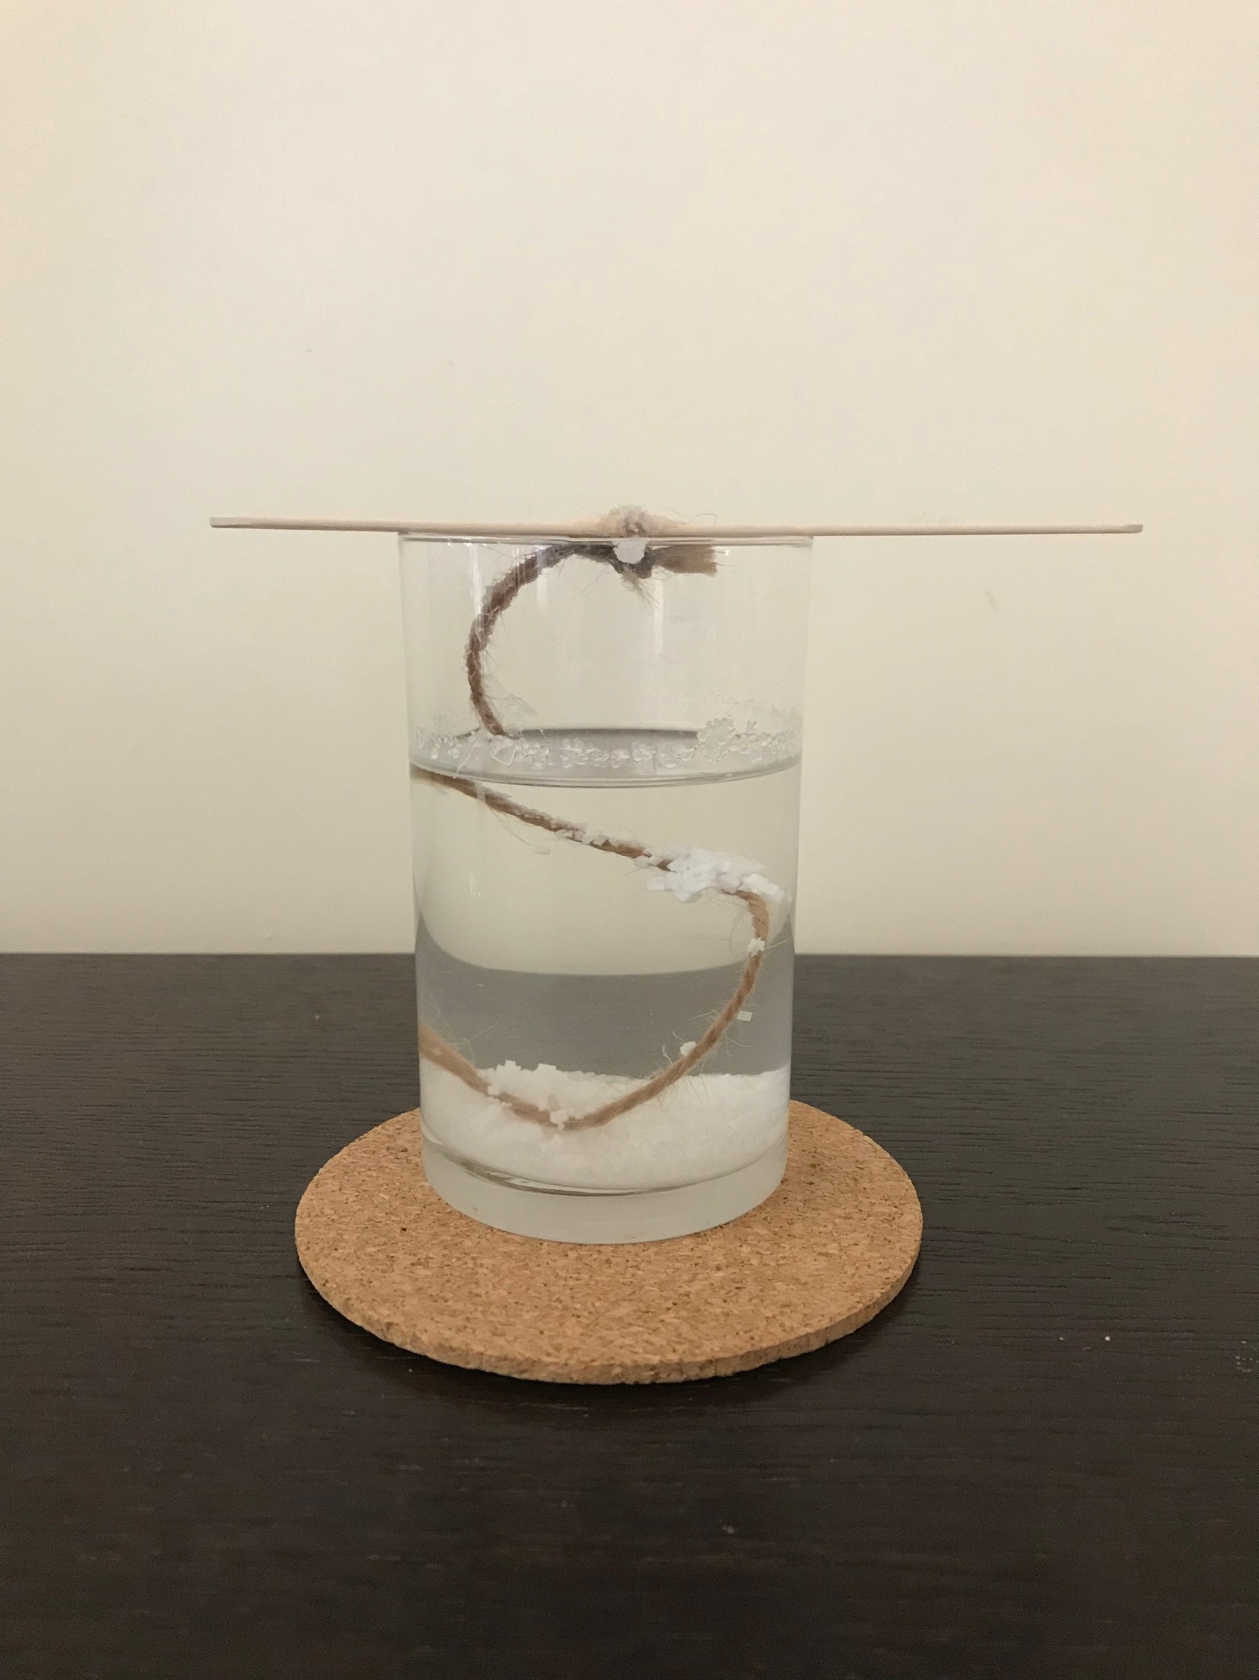
DAY 2

Slide 12
Day 3

Slide 13
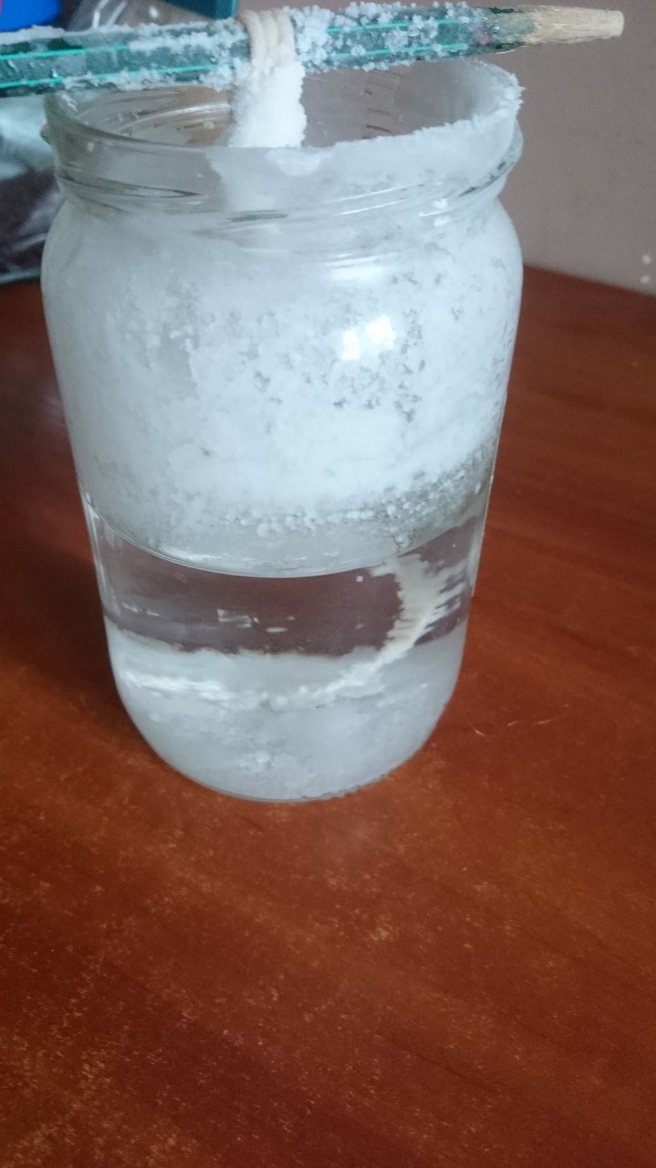
Day 4

Slide 14
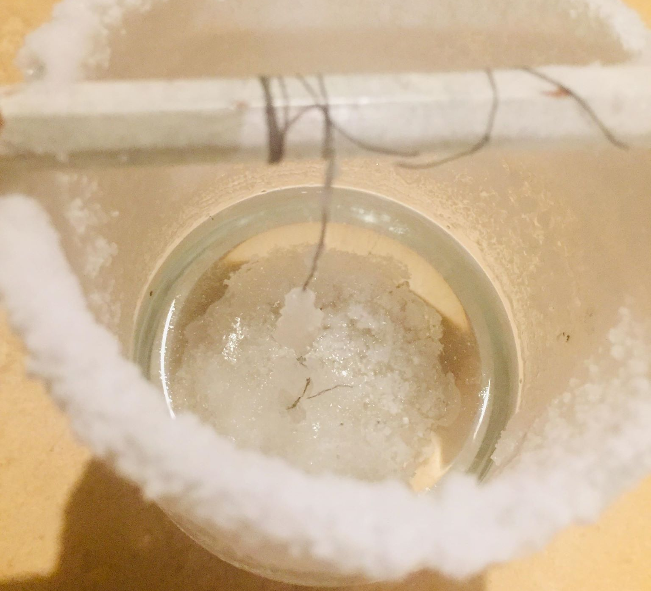
Day 5

Slide 15
Day 6

Slide 16
AFTER A FEW DAYS WE CAN OBSERVE SALT CRYSTALS IN THE GLASS AND ON A STRING

